Slide 1
Stockton Unified School District
2024-2025
Title I
Parent Meeting
A.A. Stagg High School
August 20, 2024

Slide 2
AGENDA
Title I Program Overview
Parent rights under Title I
Parent involvement
School achievement data
School Plan for Student Achievement (SPSA)
Title I Funding
Title I Parental & Family Engagement Policy
School-Parent Compact

Slide 3
Stockton Unified School District
WHAT IS TITLE I?
Title I provides additional academic support and learning opportunities for students.
The program is intended to help ensure that all students meet the California Common Core State Standards.
GOALS OF TITLE I
Increase academic achievement
Provide direct instructional support to students
Provide professional development to teachers
Promote parent education and involvement

Slide 4
PARENT RIGHTS
Ask for meetings and trainings
Review the school’s achievement data
Review the parent involvement plan and activities included in the School Plan for Student Achievement
Review and modify the school’s Title I Parental & Family Engagement Policy and School-Parent Compact

Slide 5
PARENT INVOLVEMENT
The School Site Council (SSC) provides parents with an opportunity to be involved in the academic program of the school.
The SSC develops, monitors, and evaluates the School Plan for Student Achievement to implement programs and services that support students.
Collaboration between (working together) schools and families is essential to increase student achievement.
Stockton Unified School District

Slide 6
PARENT INVOLVEMENT AT OUR SCHOOL
Parents are involved in the following activities at our site:
Parent/ Teacher Academic Conferences
FAFSA/Financial Aid Workshops
Parent Coffee Hour
Volunteer opportunities
Stockton Unified School District

Slide 7
SCHOOL ACHIEVEMENT DATA
Schools analyze the SBAC, ELPAC, and iReady assessment results and review school-wide performance data
Schools adjust instructional practices based on the findings of the performance data.
The performance data is used to align the curriculum to the state standards to improve instruction.
SBAC - Smarter Balanced Assessment Consortium
ELPAC - English Language Proficiency Assessments for California

Slide 8
OUR SCHOOL PERFORMANCE DATA
The following achievement data will be presented:
Smarter-Balanced Assessment Consortium (SBAC)
English language arts
Mathematics
English Language Proficiency Assessments for California (ELPAC)
College and career readiness assessments
PSAT
AP
ACT
SAT
Stockton Unified School District

Slide 9
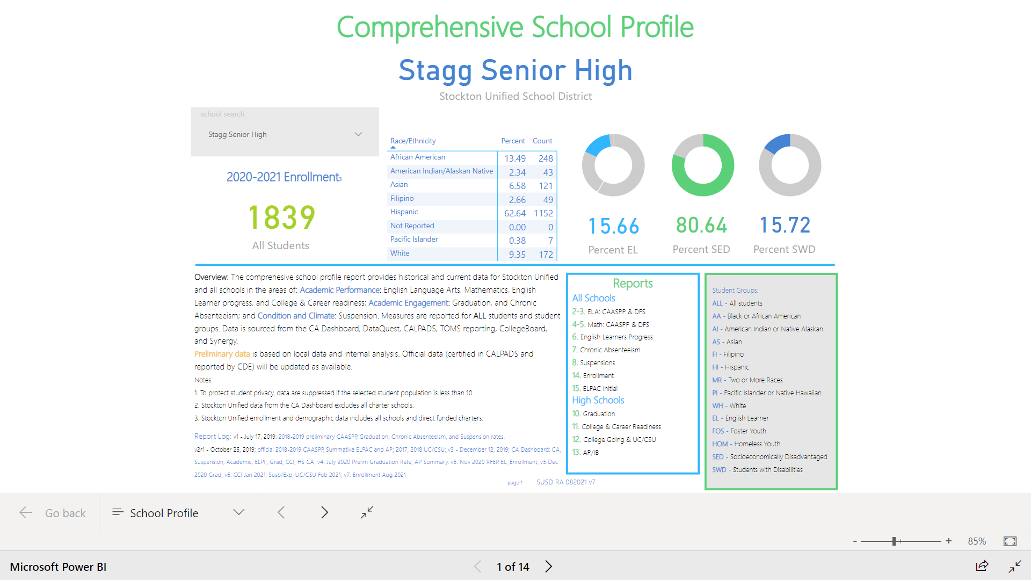
COMPREHENSIVE SCHOOL PROFILE (PRELIMINARY)
2020-2021 data is preliminary.
Final data is anticipated for Fall/Winter 2024.
Hardcopies of our school site’s Comprehensive School Profile have been made available.
Stockton Unified School District

Slide 10
SCHOOL PLAN FOR STUDENT ACHIEVEMENT
SPSAs
FOUR Required Actions:
The SPSA must be meaningfully developed with parent input.
The SPSA must be shared with ELAC, with opportunity for ELAC recommendations
The SPSA must be approved by the School Site Council.
The SPSA must be approved by the district’s governing board.
Annually evaluate the program goals
Comprehensive Needs Assessment
Review of School Performance Data
Goals and strategies to address student academic needs
Description of core and supplemental programs
Description of instructional strategies and interventions to assist struggling students
Professional needs and activities
Parent involvement strategies and activities
Alignment of Fiscal Resources with strategies
Available electronically: https://www.stocktonusd.net/Page/10028
Stockton Unified School District

Slide 11
TITLE I FUNDING
Schools are allocated funds based upon the percentage of students receiving free or reduced lunch.
Schools are ranked according to this percentage and receive a per pupil allocation.
One percent of the school’s total Title I budget is for parent involvement activities.
Total Title I Allocation: $644,495 AND Title 1 Parent $9,864
Stockton Unified School District

Slide 12
OUR SPSA STRATEGIES
Goal 1
Student Achievement
Graduation SMART Goal:
By the end of the 2024-2025 school year, the Graduation Rate will increase by 5% to remain in the Green on the CA Dashboard
College/Career SMART Goal:
By the end of the 2024-2025 school year, the College/Career Readiness Rate will increase by 10% to move into the Medium on the CA Dashboard.
Goal 2: Safe and Healthy Learning Environments:
Provide equitable and healthy learning environments that enhance the social-emotional and academic learning for all students utilizing a Multi-
Tiered System of Supports (MTSS).
Goal 3
Meaningful Partnerships
Create a culture of inclusion and collaboration with families and community stakeholders that builds meaningful partnerships focused on
increasing student engagement and family and community participation in support of developing leadership at all levels.
Stockton Unified School District

Slide 13
Every Title I school, in collaboration with parents, must prepare a site-level parental and family engagement policy.
The Policy describes how the school will involve parents in a meaningful, ongoing, and timely way.
The Policy also describes how parents will be involved in the planning, review, and improvement of the school’s Title I program and activities.
PARENT AND FAMILY
ENGAGEMENT POLICY
Stockton Unified School District

Slide 14
The Compact describes how the school and parents share the responsibility for student achievement
It is developed in collaboration among parents, teachers, and students.
The Compact is distributed annually with the Title I Parent and Family Engagement Policy
SCHOOL – PARENT COMPACT
Stockton Unified School District

Slide 15
QUESTIONS?
Brett Toliver
(209) 933-7445
https://www.stocktonusd.net/Stagg
Stockton Unified School District

